Slide 1
Elections
Thinking critically with maths

Slide 2
I can understand how members of parliament are elected.

Slide 3
First Past the Post (FPTP) is the name for the electoral system used to elect MPs to Westminster.

Slide 4

Elections
Understanding First Past the Post (FPTP)
Limitations of FPTP

Slide 5
Understanding First Past the Post (FPTP)
First Past the Post (FPTP) is the name for the electoral system used to elect MPs (members of parliament) to Westminster.
The UK is divided into 650 constituencies. Each constituency votes to elect an MP.
Each voter gets to vote for one candidate. The candidate with the most votes wins.
It doesn’t matter how many votes they win by.

Slide 6

Understanding First Past the Post (FPTP)
How many candidates can a voter vote for?
None
One
This might be the case for local council elections where there is more than one vacancy.
Two

Slide 7



Understanding First Past the Post (FPTP)
The pupils at Oak National Academy are voting for their form Captain.
There are three pupils standing for the position.
Izzy
Lucas
Sam

Slide 8
Understanding First Past the Post (FPTP)
The other seven pupils vote for who they want to be form Captain. Using FPTP, they can each cast one vote only.
Izzy
Lucas
Sam

Slide 9
Understanding First Past the Post (FPTP)
Here are the results:
2 votes
3 votes
2 votes
Izzy
Lucas
Sam

Slide 10
Understanding First Past the Post (FPTP)
Who won the election? How do you know?
2 votes
3 votes
2 votes
Izzy
Lucas
Sam

Slide 11
Understanding First Past the Post (FPTP)
Using the system First Past the Post (FPTP), it is possible to know who has won an election before all the votes are counted.

Slide 12
Understanding First Past the Post (FPTP)
There are four candidates standing in an election.
There are 100 people voting.
Candidate A wins the election. How many votes could they have received?
What is the smallest number of votes that A could have received?

Slide 13
Understanding First Past the Post (FPTP)
There are four candidates standing in an election.
There are 100 people voting.
Candidate A wins the election. How many votes could they have received?
E.g. They could have received all the votes (100).
They could have received 97 votes (and the other candidates got 1 vote each).
There are lots of possible answers!

Slide 14
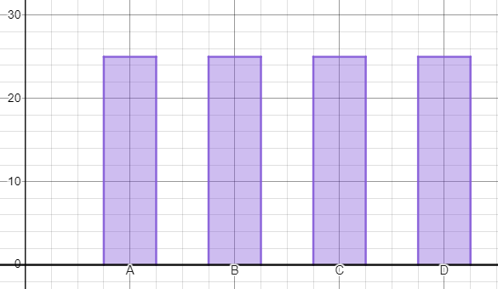
Understanding First Past the Post (FPTP)
What is the smallest number of votes that A could have received?
If everyone received 25 votes, it would have been a 4-way tie.
A only needs one more vote than the next closest candidate.

Slide 15
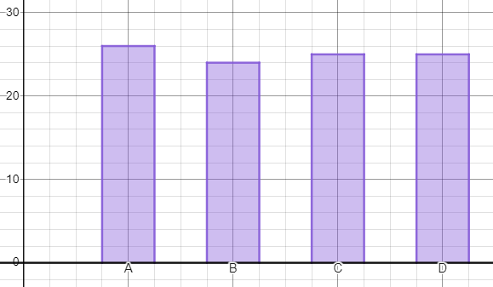
Understanding First Past the Post (FPTP)
What is the smallest number of votes that A could have received?
26 votes is the smallest number of votes possible.
Any less than that and A would not have won the election.

Slide 16
Understanding First Past the Post (FPTP)
There are 500 people voting in an election.
There are 3 candidates - A, B and C.
What is the smallest number of votes that C could receive and still win the election?

Slide 17
Understanding First Past the Post (FPTP)
There are 500 people voting in an election.
There are 3 candidates - A, B and C.
What is the smallest number of votes that C could receive and still win the election?
500 ÷ 3 = 166.66…
If C receives 167 votes, then A and B split the remaining votes 167 and 166 so 167 votes is not enough for C to win.

Slide 18
Understanding First Past the Post (FPTP)
There are 500 people voting in an election.
There are 3 candidates - A, B and C.
What is the smallest number of votes that C could receive and still win the election?
Therefore the smallest number of votes that C could receive (and still win) is 168.

Slide 19
Understanding First Past the Post (FPTP)
1) 200 people are voting in an election. There are four candidates (A, B, C, D) standing in the election.
a) Given that candidate B won the election, suggest a possible number of votes that each candidate received.
b) Given that candidate B won the election, what is the smallest number of votes candidate B could have received?

Slide 20
Understanding First Past the Post (FPTP)
2) 400 people are voting in an election. There are four candidates (A, B, C, D) standing in the election.
a) Given that candidate D won the election, suggest a possible number of votes that each candidate received.
b) Given that candidate D won the election, what is the smallest number of votes candidate D could have received?

Slide 21
Understanding First Past the Post (FPTP)
3) n (where n is a multiple of four) people are voting in an election. There are four candidates (A, B, C, D) standing in the election.
a) Given that candidate A won the election, write a general rule for the smallest number of votes candidate A could have received.
b) Write an expression for the proportion of the total vote that candidate A received.

Slide 22
Understanding First Past the Post (FPTP)
1) 200 people are voting in an election. There are four candidates (A, B, C, D) standing in the election.
a) Given that candidate B won the election, suggest a possible number of votes that each candidate received.
There are many possibilities however your solution should have candidate B with the highest number of votes and the number of votes cast should sum to 200.

Slide 23
Understanding First Past the Post (FPTP)
1) 200 people are voting in an election. There are four candidates (A, B, C, D) standing in the election.
b) Given that candidate B won the election, what is the smallest number of votes candidate B could have received?
51 votes.
(The other candidates could have received 50, 50 and 49 votes.)

Slide 24
Understanding First Past the Post (FPTP)
2) 400 people are voting in an election. There are four candidates (A, B, C, D) standing in the election.
a) Given that candidate D won the election, suggest a possible number of votes that each candidate received.
There are many possibilities however your solution should have candidate D with the highest number of votes and the number of votes cast should sum to 400.

Slide 25
Understanding First Past the Post (FPTP)
2) 400 people are voting in an election. There are four candidates (A, B, C, D) standing in the election.
b) Given that candidate D won the election, what is the smallest number of votes candidate D could have received?
101 votes.
(The other candidates could have received 100, 100 and 99 votes.)

Slide 26

Understanding First Past the Post (FPTP)
3) n (where n is a multiple of four) people are voting in an election. There are four candidates (A, B, C, D) standing in the election.
a) Given that candidate A won the election, write a general rule for the smallest number of votes candidate A could have received.

Slide 27
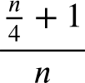
Understanding First Past the Post (FPTP)
3) n (where n is a multiple of four) people are voting in an election. There are four candidates (A, B, C, D) standing in the election.
b) Write an expression for the proportion of the total vote that candidate A received.

Slide 28
Elections
Understanding First Past the Post (FPTP)
Limitations of FPTP

Slide 29
Limitations of FPTP
Earlier we saw the results of a form Captain election at Oak National Academy.
2 votes
3 votes
2 votes
Izzy
Lucas
Sam

Slide 30

Limitations of FPTP
Lucas had the most votes so Lucas won the election.
What percentage of the total vote did Lucas receive?
2 votes
3 votes
2 votes
Izzy
Lucas
Sam

Slide 31

Limitations of FPTP
Lucas received approximately 43% of the votes.
Wait a minute! You didn’t get over 50% of the vote, so why have you won?
True, but I got more votes than you or Sam so I won.
Izzy
Lucas

Slide 32
Limitations of FPTP
In the FPTP system, it is possible for a candidate to be elected even though more people have voted against them, rather than for them.

Slide 33
Limitations of FPTP
In the FPTP system, it is possible for a candidate to be elected even though more people have voted against them, rather than for them.
A candidate wins the election if they receive more votes than any other candidate.

Slide 34
Limitations of FPTP
We are going to consider a model of a general election.
There are four parties - Party A, Party B, Party C and Party D.
There are 3 constituencies that we are considering.
This task looks at what happens in each constituency and how this affects the overall outcome.

Slide 35
Limitations of FPTP
1) Constituency 1 - this is the breakdown of the vote.
a) Which party won the election in this constituency?
b) What percentage of the total vote did each party receive? (Round to the nearest percent.)
Party A | Party B | Party C | Party D
5772 | 6889 | 3424 | 789

Slide 36
Limitations of FPTP
2) Constituency 2 - this is the breakdown of the vote.
a) Which party won the election in this constituency?
b) What percentage of the total vote did each party receive? (Round to the nearest percent.)
Party A | Party B | Party C | Party D
4930 | 5381 | 4729 | 1291

Slide 37
Limitations of FPTP
3) Constituency 3 - this is the breakdown of the vote.
a) Which party won the election in this constituency?
b) What percentage of the total vote did each party receive? (Round to the nearest percent.)
Party A | Party B | Party C | Party D
21 953 | 7116 | 4581 | 2093

Slide 38
Limitations of FPTP
4) By considering your answers to questions 1-3, answer the following:
a) Which party won the election in the most constituencies?
b) By considering the total number of votes cast across the three constituencies, what percentage of the vote did each party win? Write a paragraph explaining what this means.

Slide 39
Limitations of FPTP
1) Constituency 1 - this is the breakdown of the vote.
a) Which party won the election in this constituency?
Party B as they received more votes than any other party.
Party A | Party B | Party C | Party D
5772 | 6889 | 3424 | 789

Slide 40
Limitations of FPTP
1) Constituency 1 - this is the breakdown of the vote.
b) What percentage of the total vote did each party receive? (Round to the nearest percent.)
Party A | Party B | Party C | Party D
5772 | 6889 | 3424 | 789
Party A | Party B | Party C | Party D
34% | 41% | 20% | 5%

Slide 41
Limitations of FPTP
2) Constituency 2 - this is the breakdown of the vote.
a) Which party won the election in this constituency?
Party B as they received more votes than any other party.
Party A | Party B | Party C | Party D
4930 | 5381 | 4729 | 1291

Slide 42
Limitations of FPTP
2) Constituency 2 - this is the breakdown of the vote.
b) What percentage of the total vote did each party receive? (Round to the nearest percent.)
Party A | Party B | Party C | Party D
4930 | 5381 | 4729 | 1291
Party A | Party B | Party C | Party D
30% | 33% | 29% | 8%

Slide 43
Limitations of FPTP
3) Constituency 3 - this is the breakdown of the vote.
a) Which party won the election in this constituency?
Party A as they received more votes than any other party.
Party A | Party B | Party C | Party D
21 953 | 7116 | 4581 | 2093

Slide 44
Limitations of FPTP
3) Constituency 3 - this is the breakdown of the vote.
b) What percentage of the total vote did each party receive? (Round to the nearest percent.)
Party A | Party B | Party C | Party D
21 953 | 7116 | 4581 | 2093
Party A | Party B | Party C | Party D
61% | 20% | 13% | 6%

Slide 45
Limitations of FPTP
4) By considering your answers to questions 1-3, answer the following:
a) Which party won the election in the most constituencies?
Party B as they won two out of three constituencies.

Slide 46
Limitations of FPTP
4) By considering your answers to questions 1-3, answer the following:
b) By considering the total number of votes cast across the three constituencies, what percentage of the vote did each party win? Write a paragraph explaining what this means.
68 948 votes cast in total. (Approximate percentages below.)
Party A | Party B | Party C | Party D
47% | 28% | 18% | 6%

Slide 47
Limitations of FPTP
b) Write a paragraph explaining what this means.
68 948 votes cast in total.
Despite Party A receiving the most votes across the constituencies, Party B still won more individual constituencies. Party A may be more popular but it does not have as many elected members as Party B does.
Party A | Party B | Party C | Party D
47% | 28% | 18% | 6%

Slide 48
Elections
First Past the Post (FPTP) is the name for the electoral system used to elect MPs to Westminster.
The number of MPs a party has in parliament rarely matches their popularity.
Fewer people can vote for a party but they can win more seats.

Slide 49

© Oak National Academy 2024.
Produced in partnership with Mathematics in Education and Industry.
Licensed on the Open Government Licence v3.0, except where otherwise stated. See Oak terms and conditions.

